Slide 2
L E A R N I N G O U T L I N E
Follow this Learning Outline as you read and study this chapter.
Who Are Managers?
  Describe who is doing managerial work in today’s organizations.
  Define who managers are.
  Explain how manager differ from non-managerial employees.
  Discuss how to classify managers in organizations.
What Is Management?
  Define management.
  Contrast efficiency and effectiveness.
  Explain why efficiency and effectiveness are important to management.
Copyright © 2005 Prentice Hall, Inc. All rights reserved.
1–<number>

Slide 3
L E A R N I N G O U T L I N E (cont’d)
Follow this Learning Outline as you read and study this chapter.
What Do Managers Do?
  Describe the four functions of management.
  Explain Mintzberg’s managerial roles.
  Tell how a manager’s include reflection and action.
  Describe Katz’s three essential managerial skills and how the importance of these skills changes depending on managerial level.
  List other important managerial skills and competencies.
  Discuss the change that are impacting managers’ jobs.
  Explain why customer service and innovation are important to the manager’s job.
Copyright © 2005 Prentice Hall, Inc. All rights reserved.
1–<number>

Slide 4
L E A R N I N G O U T L I N E (cont’d)
Follow this Learning Outline as you read and study this chapter.
What Is An Organization?
  Describe the characteristics of an organization.
  Explain how the concept of an organization is changing.
Why Study Management?
  Explain the universality of management concept.
  Discuss why an understanding of management is important even if you don’t plan to be a manager.
  Describe the rewards and challenges of being a manager.
Copyright © 2005 Prentice Hall, Inc. All rights reserved.
1–<number>

Slide 5
Who Are Managers?
Manager
  Someone who works with and through other people by coordinating and integrating their work activities in order to accomplish organizational goals.
Copyright © 2005 Prentice Hall, Inc. All rights reserved.
1–<number>

Slide 6
Classifying Managers
First-line Managers
  Are at the lowest level of management and manage the work of non-managerial employees.
Middle Managers
  Manage the work of first-line managers.
Top Managers
  Are responsible for making organization-wide decisions and establishing plans and goals that affect the entire organization.
Copyright © 2005 Prentice Hall, Inc. All rights reserved.
1–<number>

Slide 7
What Is Management?
Managerial Concerns
  Efficiency
    “Doing things right”
      Getting the most output for the least inputs
  Effectiveness
    “Doing the right things”
      Attaining organizational goals
Copyright © 2005 Prentice Hall, Inc. All rights reserved.
1–<number>

Slide 8
What Do Managers Do?
Functional Approach
  Planning
    Defining goals, establishing strategies to achieve goals, developing plans to integrate and coordinate activities
  Organizing
    Arranging work to accomplish organizational goals
  Leading
    Working with and through people to accomplish goals.
  Controlling
    Monitoring, comparing, and correcting the work
Copyright © 2005 Prentice Hall, Inc. All rights reserved.
1–<number>

Slide 9
What Do Managers Do? (cont’d)
Management Roles Approach
  Interpersonal roles
    Figurehead, leader, liaison
  Informational roles
    Monitor, disseminator, spokesperson
  Decisional roles
    Disturbance handler, resource allocator, negotiator
Copyright © 2005 Prentice Hall, Inc. All rights reserved.
1–<number>

Slide 10
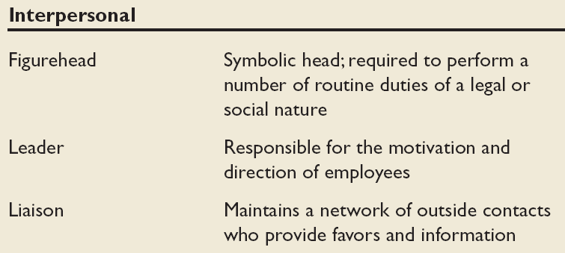
Management Roles Approach (cont)
Copyright © 2005 Prentice Hall, Inc. All rights reserved.
1–<number>

Slide 11
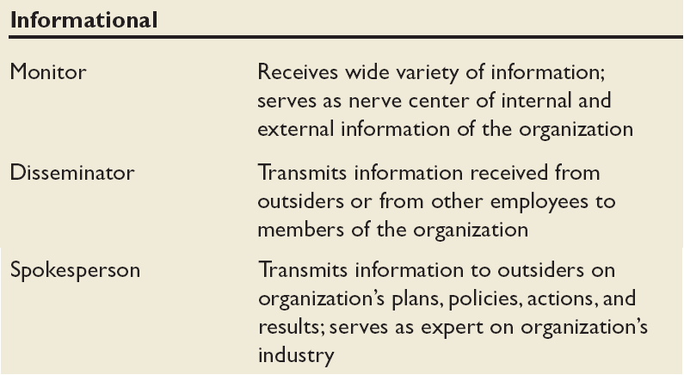
Management Roles Approach (cont)
Copyright © 2005 Prentice Hall, Inc. All rights reserved.
1–<number>

Slide 12
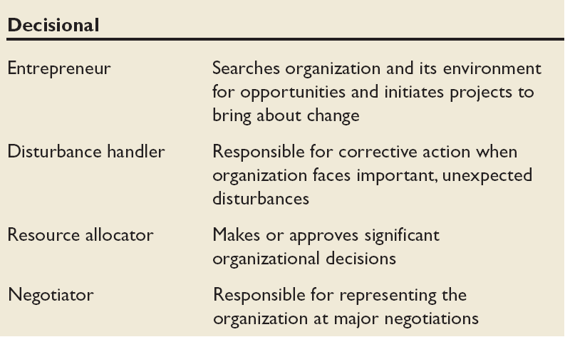
Management Roles Approach (cont)
Copyright © 2005 Prentice Hall, Inc. All rights reserved.
1–<number>

Slide 13
What Do Managers Do? (cont’d)
Skills Approach
  Technical skills
    Knowledge and proficiency in a specific field
  Human skills
    The ability to work well with other people
  Conceptual skills
    The ability to think and conceptualize about abstract and complex situations concerning the organization
Copyright © 2005 Prentice Hall, Inc. All rights reserved.
1–<number>

Slide 14
How The Manager’s Job Is Changing
The Increasing Importance of Customers
  Customers: the reason that organizations exist
    Managing customer relationships is the responsibility of all managers and employees.
    Consistent high quality customer service is essential for survival.
Innovation
  Doing things differently, exploring new territory, and taking risks
    Managers should encourage employees to be aware of and act on opportunities for innovation.
Copyright © 2005 Prentice Hall, Inc. All rights reserved.
1–<number>

Slide 15
What Is An Organization?
An Organization Defined
  A deliberate arrangement of people to accomplish some specific purpose
Common Characteristics of Organizations
  Have a distinct purpose (goal)
  Composed of people
  Have a deliberate structure
Copyright © 2005 Prentice Hall, Inc. All rights reserved.
1–<number>

Slide 16
Why Study Management?
The Value of Studying Management
  The universality of management
    Good management is needed in all organizations.
  The reality of work
    Employees either manage or are managed.
  Rewards and challenges of being a manager
    Management offers challenging, exciting and creative opportunities for meaningful and fulfilling work.
    Successful managers receive significant monetary rewards for their efforts.
Copyright © 2005 Prentice Hall, Inc. All rights reserved.
1–<number>

